Slide 1
Desoutter Industrial Tools
Nantes & 11/2015

Slide 2
Revision
Revision n° | Date | Modification | Author
00 | 19/11/2015 | Creation | XRI
1 | 19/11/2015 | First Version – Documenting Pre-Release Version | XRI
1.1 | 20/11/2015 | Updates to in-application features | APA
1.2 | 25/11/2015 | Updated to document v6.0.44.528 | APA
1.3 | 12/03/2016 | Updated to document v6.2.x.x | APA

Slide 3
Table of contents
Generalities
System
Process
Diagnostics / Logs
3

Slide 4
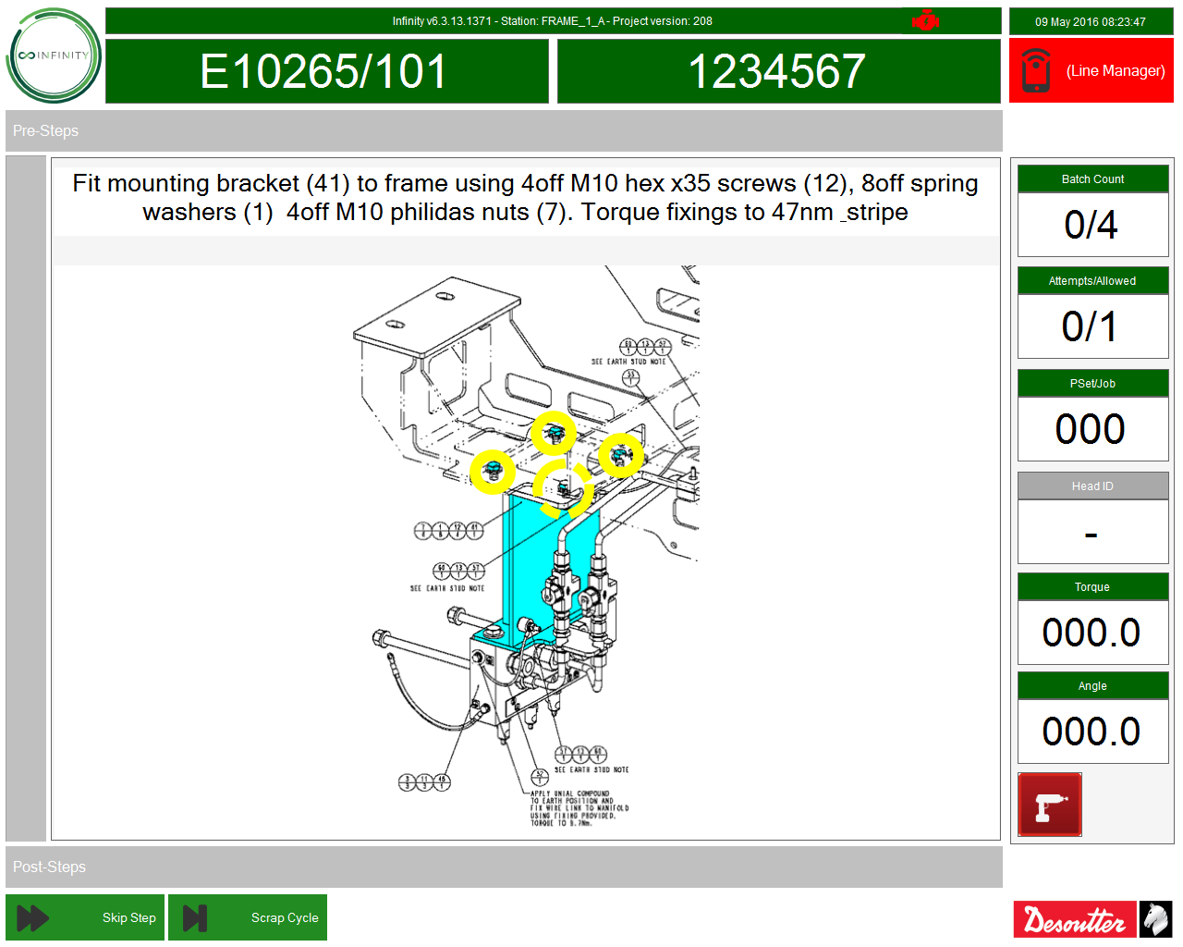
Generalities
Generalities System Process Diagnostics / Logs
Infinity Client
The Infinity Client is a comprehensive modular system providing a process control solutions that works effectively as a single station or plant wide installation.
Every Infinity Station allows for:
Digital Work Instructions
Conditional Logic and Automatic Decision-Making
Real-time Data Capture
Offline Data Storage
Conditional User Access Rights
Loadable Media
Interaction with Open Protocol and non-Open Protocol Tooling
TAKT Time Integration
The End user also has facilities to:
Diagnose Communication Errors Quickly
Store Log files locally to the device for analysis
Test I/O Connected to the device
4

Slide 5
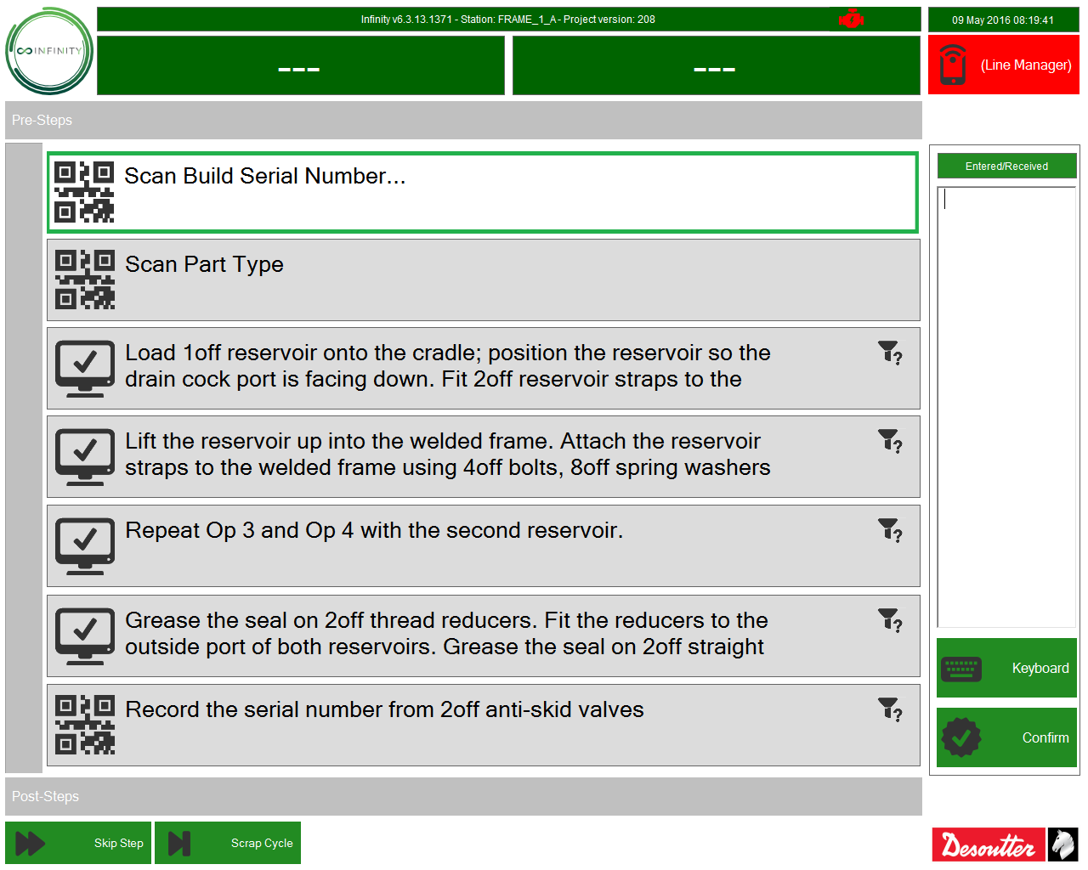
System
Generalities System Process Diagnostics / Logs
System Initialisation
The initialisation screen allows the end user to see an overview of all peripheral components within the process and their connection state to the station at the time.
The End User can see details for
The Process Type and Deployment Date
System Service Communications
I/O Status and I/O Type
Tooling Assets
Positioning System Assets
Other Assets such as Vision Systems
5

Slide 6
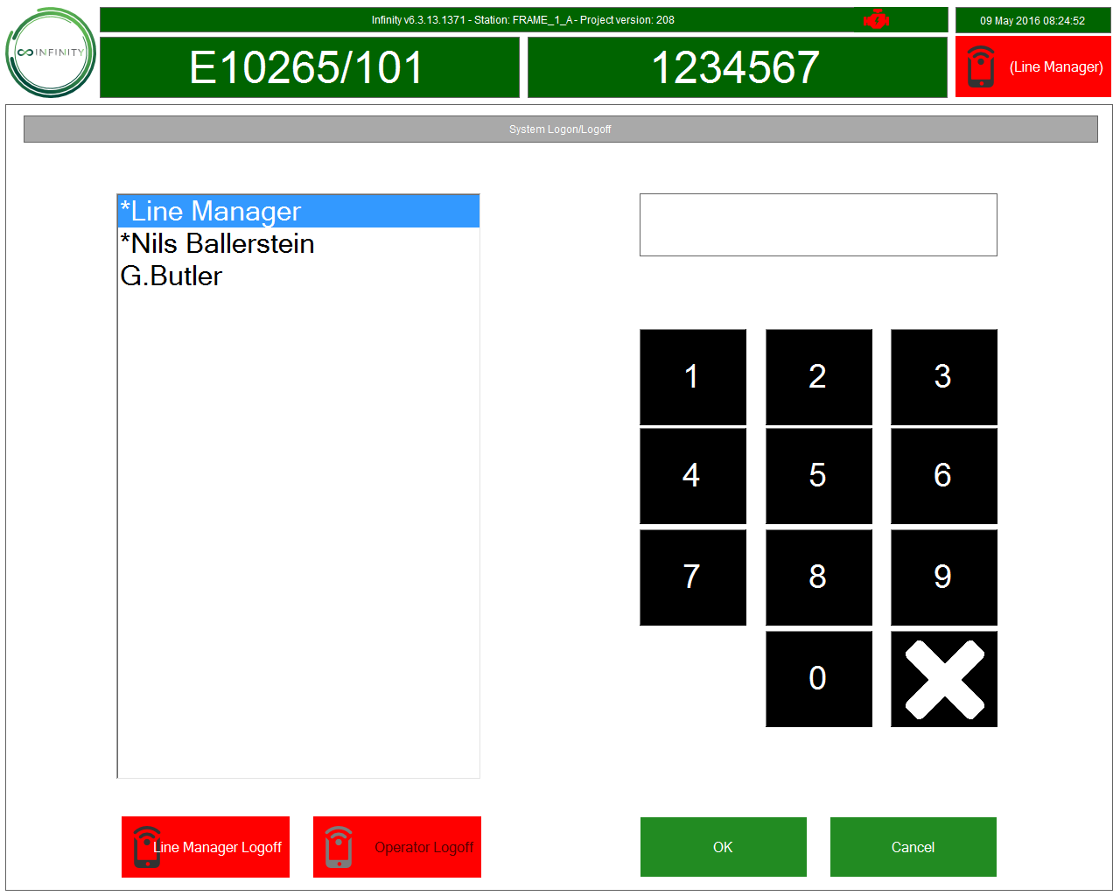
System
Generalities System Process Diagnostics / Logs
User login
System Login/Logoff is used so that an operator or supervisor can gain access to the process or features within the Infinity application
User login screen :
*xxxxx : supervisor
xxxxx : user
The access permissions of a user and a supervisor are defined using Fusion Management Software.
6

Slide 7
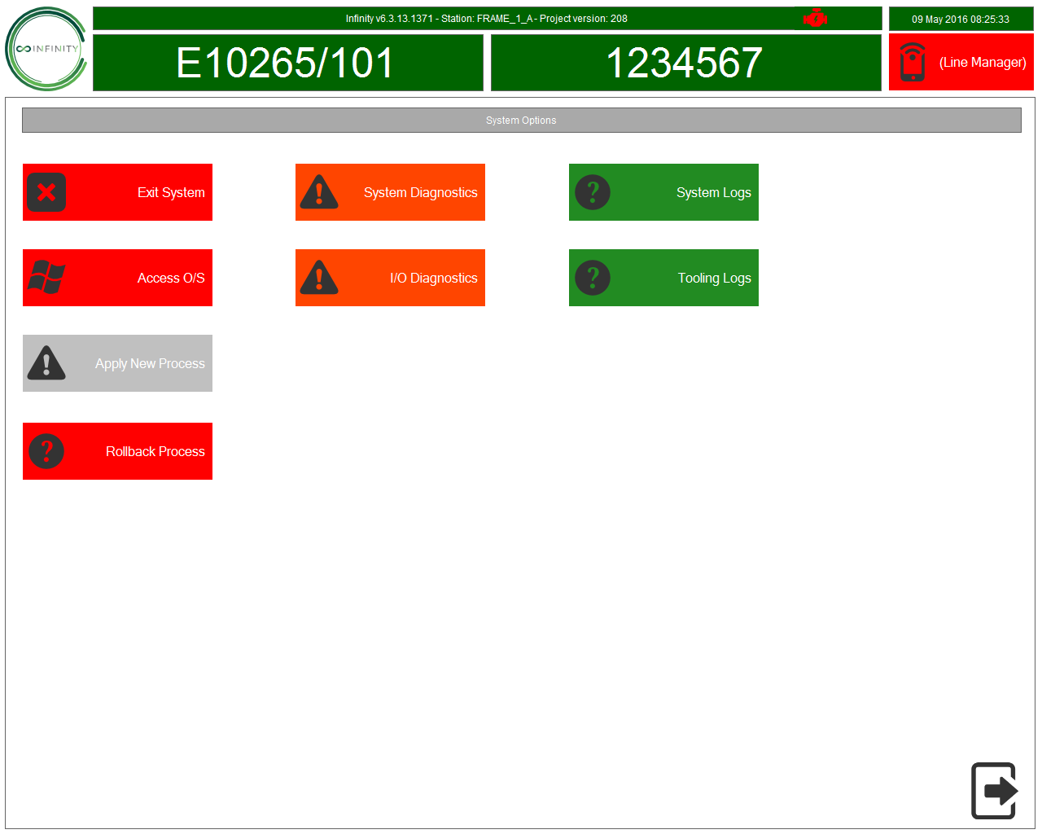
System
Generalities System Process Diagnostics / Logs
System options
System Options allow the end user to open features inside of the Infinity application that allow for process changes, exiting the application, viewing data and diagnosing issues within the process
Available Options:
High Level Option (Red) – Exiting the System, Deploying Process Changes, Reverting to Older Process
Medium Level Options (Orange) – Diagnostics and Calibration Options
Low Level Options (Green) – Logged Process Data, Logged Tooling Communications
7

Slide 8
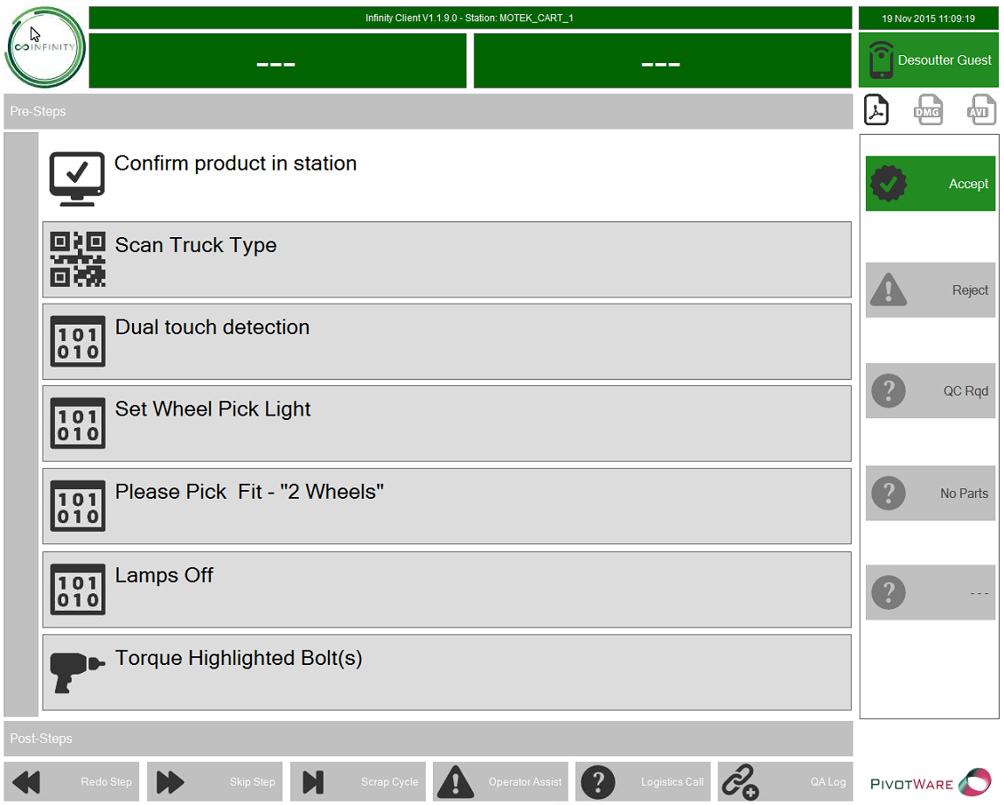
Process
Generalities System Process Diagnostics / Logs
Process
Operator Validation/Confirmation Step
Allows the end user to input the outcome of the given instruction.
User Inputs
Accept – Allows user to confirm the action and continue in the process
Reject – Allows user to deem action not finished or not to standard
Note: All controls within a step are configured through Fusion and deployed to the Infinity application.
8

Slide 9
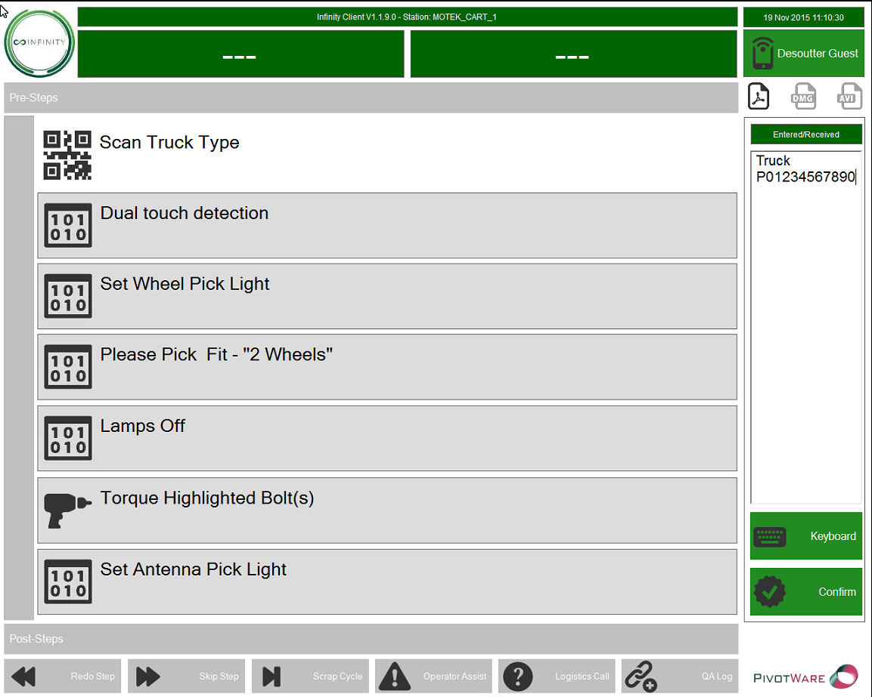
Process
Generalities System Process Diagnostics / Logs
Process
Data In Step
Allows the user to enter data into the process manually through a keyboard or scanner.
Available Features
Data Entered/Received – Area that show what data has been received over USB or through the use of a keyboard.
Keyboard – Allows the user to show an on-screen keyboard so they can manually type in data.
Confirm – Allows a user to confirm entered or received data if no terminating character has been set up.
9

Slide 10
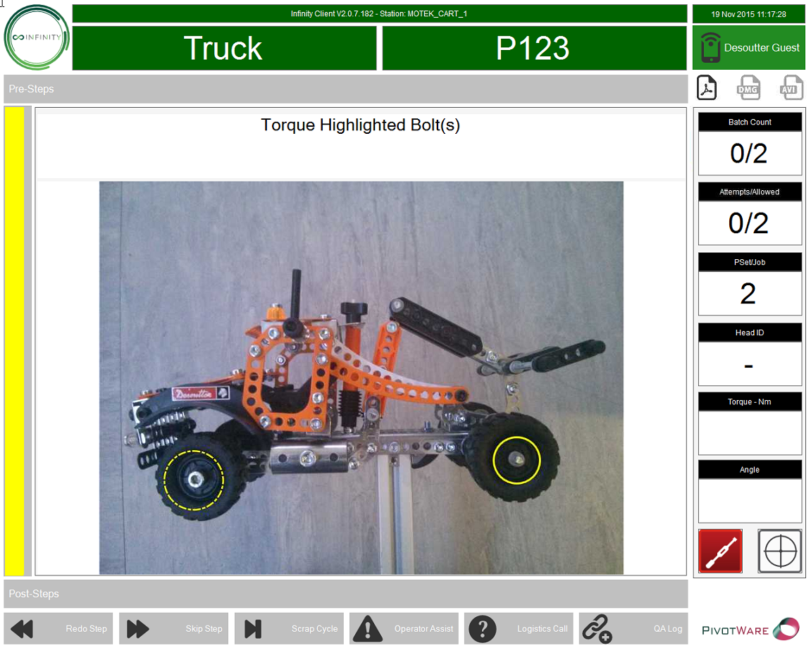

Process
Generalities System Process Diagnostics / Logs
Process
Tooling Step
End User is guided to use specific tools with specific tightenings in a certain order, an image to aid is optional as well as guided hotspots.
Optional Step Image – An assigned image giving extra detail to a step in a cycle, hotspots can also be allocated per tightening to give precise locations of each tightening.
Tool Connectivity – Shows the connection state of a tool (Red = disconnected/Green = Connected)
Tooling Data – Shows tightening results from the most current tightening.
If the end user uses all their attempts at a tightening – amount set in Fusion – then the tool will be locked. The step must then be skipped or a supervisor can unlock the tool by logging in.
10

Slide 11

Process
Generalities System Process Diagnostics / Logs
Process
Step and Process management
During a cycle:
Steps can be skipped
Process cycles can be scrapped
Access to these features can be configured in Fusion based on user log on
11

Slide 12
Diagnostic / Logs
Generalities System Process Diagnostics / Logs
Diagnostics and logs
Diagnostics and logs are available by going to the options menu including:
Tooling Communications
I/O Diagnostics
Recent Traceability
12

Slide 13
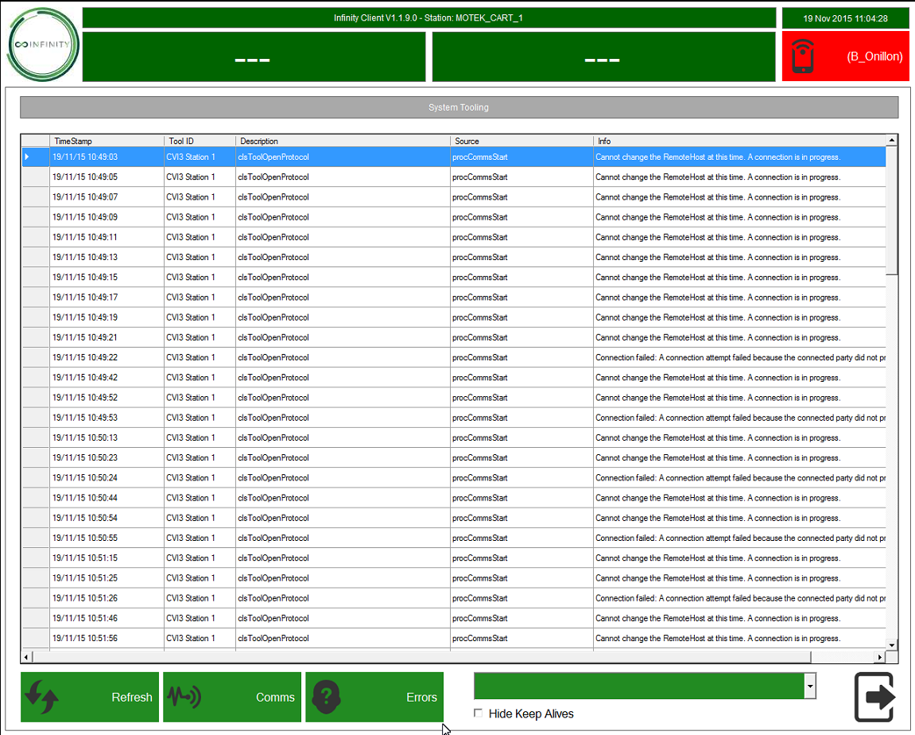
Diagnostic / Logs
Generalities System Process Diagnostics / Logs
Diagnostics and logs
Tooling Diagnostics
Tooling Diagnostics shows the user communications between tool and the Infinity application.
The user can choose which tool to see communications with as well as see successful communication, errors or both.
13

Slide 14
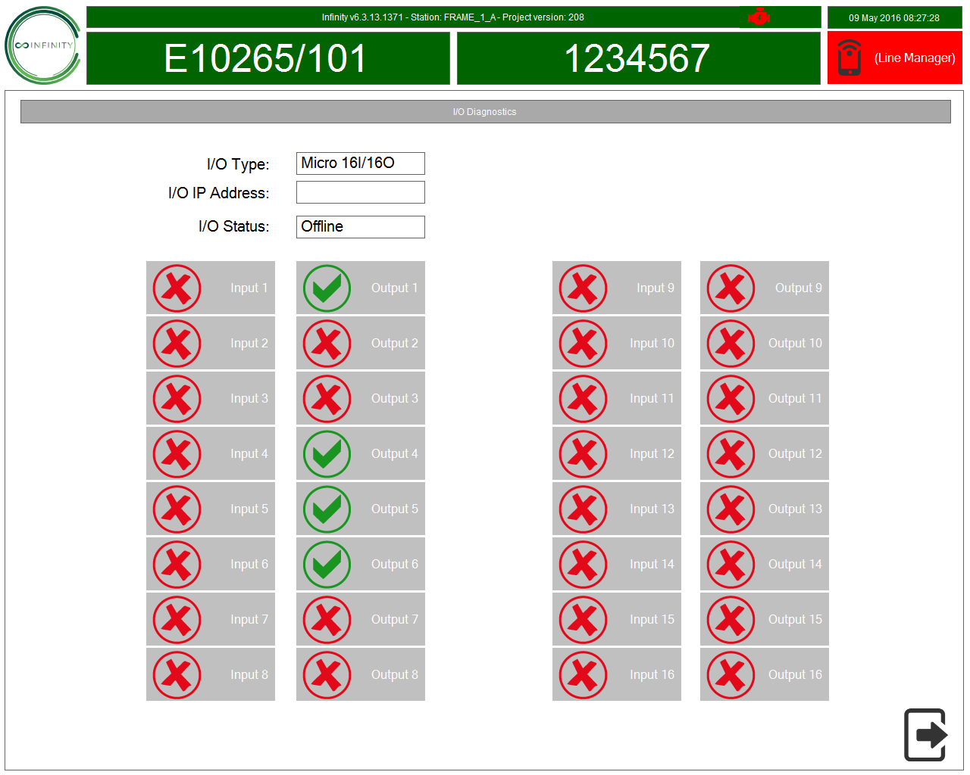
Diagnostic / Logs
Generalities System Process Diagnostics / Logs
Diagnostics and logs
I/O Diagnostics
I/O Diagnostics shows the user current I/O interations.
Inputs are marked as green when active.
Users can manually turn outputs off and on in order to diagnose I/O issues
14

